Slide 1
Cloud Pak For Data Install Prep IBM Data and AI Expert Lab
Nov 2019

Slide 2
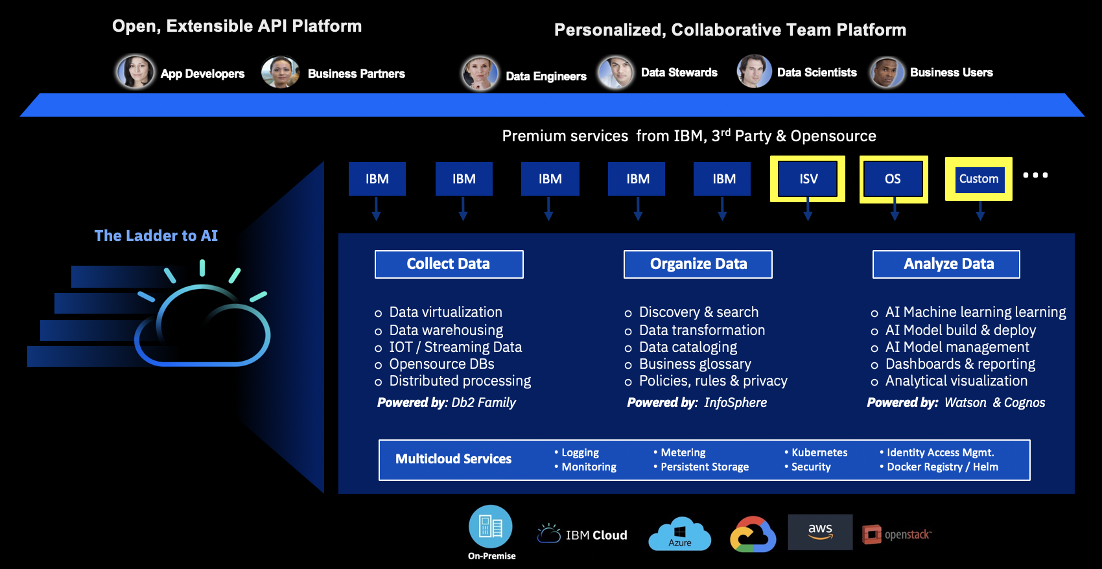
Cloud Pak for Data v2.5
Cartridges
Db2
DataStage
Watson Studio Premium
Cognos Analytics
Watson Assistant
Watson Discovery
Watson API Kit
Watson Financial Crimes Insights
Cloud Pak for Data Enterprise Edition
Optional Modules
Watson Studio (includes Data Refinery)
Watson Knowledge Catalog (Including IGC)
Db2 Warehouse
Data Virtualization
Cognos Dashboards Embedded
Watson Machine Learning (Including AutoAI)
IBM Regulatory Accelerator
Watson OpenScale
Analytics Engine for Apache Spark
Open source governance
IBM Performance Server (CPD System only)
Db2 EventStore
IBM Streams
Control Plane
Zen Shell
User Management
Roles & Privileges
Add-on service mgmt.
Kubernetes Platform - OpenShift
Logging
Monitoring
Metering
Persistent volume /Storage
Kubernetes
Security
Identity Access Mgmt.
Docker registry/Helm chart mgmt.

Slide 3
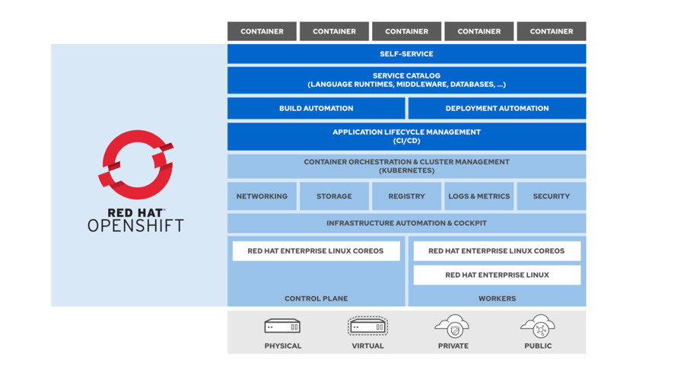
OpenShift Components
The Red Hat OpenShift product family integrates many components:
The Red Hat Enterprise Linux CoreOS container-optimized, immutable operating system.
The CRI-O engine, a small footprint, Open Container Initiative (OCI)-compliant container runtime engine with a reduced attack surface.
Kubernetes, an open source container orchestration platform.
A self-service web console.
A number of preinstalled application services, such as an internal container image registry and monitoring framework.
Certified container images for multiple programming language runtimes, databases, and other software packages.
Source:
Notes:
RHOCP runs on Red Hat Enterprise Linux CoreOS, Red Hat's lightweight operating system that focuses on agility, portability, and security.
Red Hat Enterprise Linux CoreOS (RHEL CoreOS) is an immutable operating system that is optimized for running containerized applications. The entire operating system is updated as a single image, instead of on a package-by-package basis, and both user applications and system components such as network services run as containers.
RHOCP controls updates to RHEL CoreOS and its configurations, and so managing an OpenShift cluster includes managing the operating system on cluster nodes, freeing system administrators from these tasks and reducing the risk of human error.

Slide 4
CPD Deployment Architecture
ROUTING LAYER
OPENSHIFT
MASTER NODEs
INFRA NODEs
API/
ANTHENTICATION
DATA STORE
POD1
APP
POD2
MANAGEMENT/
REPLICATION
APP
SCM (Git/Svn)
SCHEDULER
POD3
APP
REHL OR ATOMIC HOST
REHL OR ATOMIC HOST
NFS
CI/CD
NODE (CPD WORKER)
2. Cartridges
DataStage
MongoDB
AI OpenScale
…
Existing Automation Toolsets
1. Cloud Pak for Data
Portworx
Optional Modules
Db2 Warehouse
Data Virtualization
Additional Analytics Environment
CPD Control Plane
Watson Studio
Watson Knowledge Catalog
Watson ML
Other OCP provisioners
REHL OR ATOMIC HOST
SERVICE LAYER
CERTIFIED HARDWARE / CLOUD PROVIDER

Slide 5
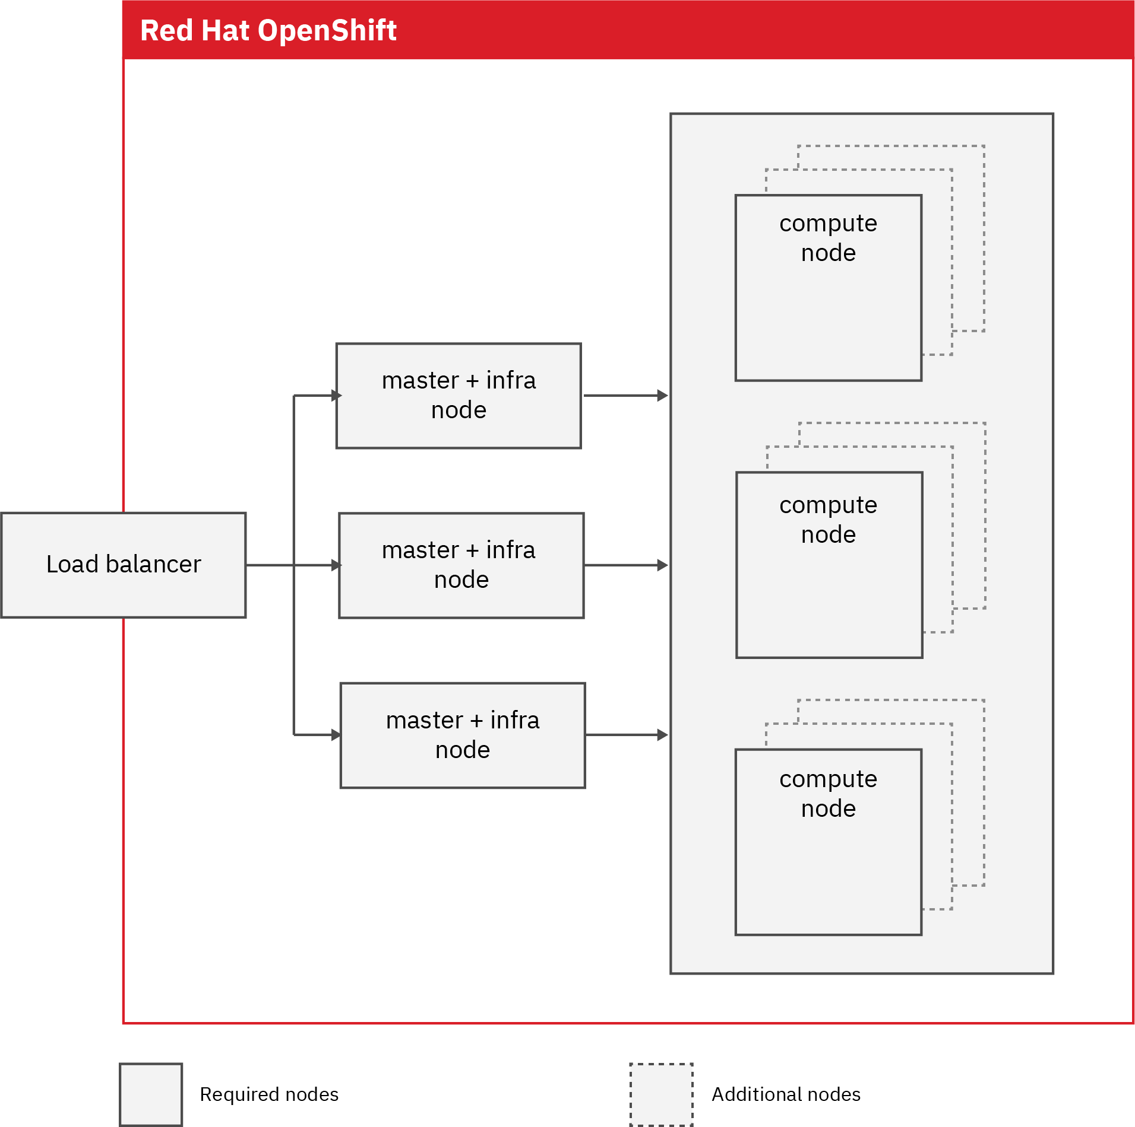

Cloud Pak for Data - node topology for deployment ( one instance)
Each node is a virtual or physical server
Users

Slide 6
Installation setup with NFS only storage
Bastion
Local
Load Balancer
Master
Worker
Users
Local
Local
NFS
Local
NFS Server
Local storage : 300 gb
NFS storage : Registry and Persistent Volumes
Bastion node used for all install activities. Can also be used to stage all software rpms
NFS Server can be running on Master3

Slide 7
Suggested Deployment Summary for minimum instance with NFS storage (minimum , no DV, db2wh)
Local storage : 300 gb for root, /tmp and /var/local/docker
NFS storage : For Registry
Portworx storage for Persistent Volumes. Add 1 additional 700 gb disk per worker node
Bastion node used for all install activities. Can also be used to stage all software rpms
NFS Server can be running on Master3

Slide 8
Installation setup with NFS and Portworx storage
Bastion
Local
Persistent volumes
Portworx
Load Balancer
Master
Worker
Portworx
Users
Portworx
Local
Local
NFS Registry
Local
NFS Server
Local storage : 300 gb for root, /tmp and /var/local/docker
NFS storage : For Registry
Portworx storage for Persistent Volumes. Add 1 additional 700 gb disk per worker node
Bastion node used for all install activities. Can also be used to stage all software rpms
NFS Server can be running on Master3

Slide 9
Suggested Deployment Architecture for with Portworx storage
/root can be split /var 250 gb /tmp 50 gb /root 20 gb
Portworx provide HA and replication out of the box
CRI-O will be container runtime used with Portworx storage. OpenShift will need to enable this option : https://www.ibm.com/support/producthub/icpdata/docs/content/SSQNUZ_current/cpd/plan/rhos-reqs.html
500 GB NFS is used for docker registry, can be made available from outside master/worker cluster.

Slide 10
System requirement
Items | Requirement
OS version | Redhat 7.6+
SELINUX | enforcing
OS level file systems | Use XFS filesystem with ftype=1 flag set Make NFS with flags ( rw,no_root_squash)
Disk requirements | https://docs.openshift.com/container-platform/3.11/install/prerequisites.html#system-requirements
Network requirements | minimum 1 GB network between the nodes Access to DNS server in the environment Shared network between master and workers See port listing that are used by OpenShift and will need to be open for intra-cluster communication : https://docs.openshift.com/container-platform/3.11/install/prerequisites.html
AirGap Environment | Use a linux node that has internet access to run CPD installer and transfer tar files and setup local repo : https://www.ibm.com/support/producthub/icpdata/docs/content/SSQNUZ_current/cpd/install/install.html
Clock synchronization | synchronize the clocks on each node in the cluster within 500 ms
Bastion node | Can use additional linux node with internet connectivity to download and stage repo files and run installer.
On all vms OS tunable | vm.max_map_count=262144 kernel.sem = 250 1024000 32 4096 For CRI-O, add pids_limit = 8192 under the [crio.runtime] section in the /etc/crio/crio.conf file.
CRI-O container runtime | With Portworx storage CRI-O will be container runtime. See how to setup CRI-O : https://www.ibm.com/support/producthub/icpdata/docs/content/SSQNUZ_current/cpd/plan/rhos-reqs.html
Advance Vector Extensions ( avx) | To ensure analytics model frameworks work make sure worker nodes have avx flag. Run “lscpu” command and see “flags” section to validate. This is required for WSL,WDS,WA .
DNS wildcard entry | Ensure DNS server has this entry : *.apps.<dns> for e.g. *.apps.cpd.mycompnay.com

Slide 11
Verify these setting and send output - 1/2
cat /etc/sysctl.conf
kernel.sem = 250 1024000 32 4096
vm.max_map_count=262144
ntpstat / chronyc tracking
verify all node clocks are within 500 mili seconds
df –hT from each node
lsblk from each node
lscpu from each node
cat /etc/selinux/config
cat /etc/resolve.conf make sure DNS is setup to resolve fqdn
yum repolist
ansible version 2.6.xx - make sure we can ssh into all master/worker/lb nodes for ansible to work
on nfs node cat /etc/exports make sure we have all master/worker/lb listed with specific flags for e.g.
cat /etc/exports
/data 172.16.47.222(rw,sync,no_root_squash,anonuid=1000,anongid=2000)
172.16.47.223(rw,sync,no_root_squash,anonuid=1000,anongid=2000)
172.16.47.224(rw,sync,no_root_squash,anonuid=1000,anongid=2000)
Or have wildcard entry /data *(rw,sync,no_root_squash,anonuid=1000,anongid=2000)

Slide 12
Verify these setting and send output - 2/2
Add dns wildcard entry *.apps.<lb node fqdn> expecting nslookup to be something like this :
nslookup *.apps.vk2500a-lb-1.fyre.ibm.com
Server: 9.30.51.66
Address: 9.30.51.66#53
Non-authoritative answer:
*.apps.vk2500a-lb-1.fyre.ibm.com canonical name = vk2500a-lb-1.fyre.ibm.com.
Name: vk2500a-lb-1.fyre.ibm.com

Slide 13
What software to download (passport advantage for customers)
Name | Description | Part#
Cloud Pak For Data | IBM Cloud Pak for Data Enterprise Edition | CC3Y1ML
Cloud Pak For Data | IBM Cloud Pak for Data Cloud Native Edition | CC3YTML
Customers will need to download entitlement API Key file from : https://myibm.ibm.com/products-services/containerlibrary
The API keys will be used inside repo.yaml file downloaded as a result of .bin file execution.
Notes:
Success…and then use case with it …..

Slide 14
Deployment Steps
Provision VM
OCP installation
Storage set up
CPD install
Add-on install
Provision vms according to the deployment architecture and detailed requirement for each type of nodes
Install OCP 3.11 on the provisioned GCP environment and validate the basic functionalities of the OCP cluster.
Set up Storage for CP4D and essential add-ons as persistent volumes. Storage type may include NFS, GlusterFS and Ceph.
Deploy CPD on top of the ICP or OCP cluster and validate the basic functionaliies of the CPD cluster.
Deploy Add-ons required in pilot #1 and pilot #2, including Data virtualization, DataStage and others.
14
Notes:
Success…and then use case with it …..

Slide 15
Airgap Instruction links
https://www.ibm.com/support/producthub/icpdata/docs/content/SSQNUZ_current/cpd/install/ag-install-prep.html
Notes:
Success…and then use case with it …..

Slide 16
User Access to Cloud Pak For Data
From Openshift Web Console -> Choose Project for CPD (“zen” is one example) ->
Choose “Application” -> Choose “Routes” -> Click on the ”Hostname”
Notes:
Success…and then use case with it …..

Slide 17
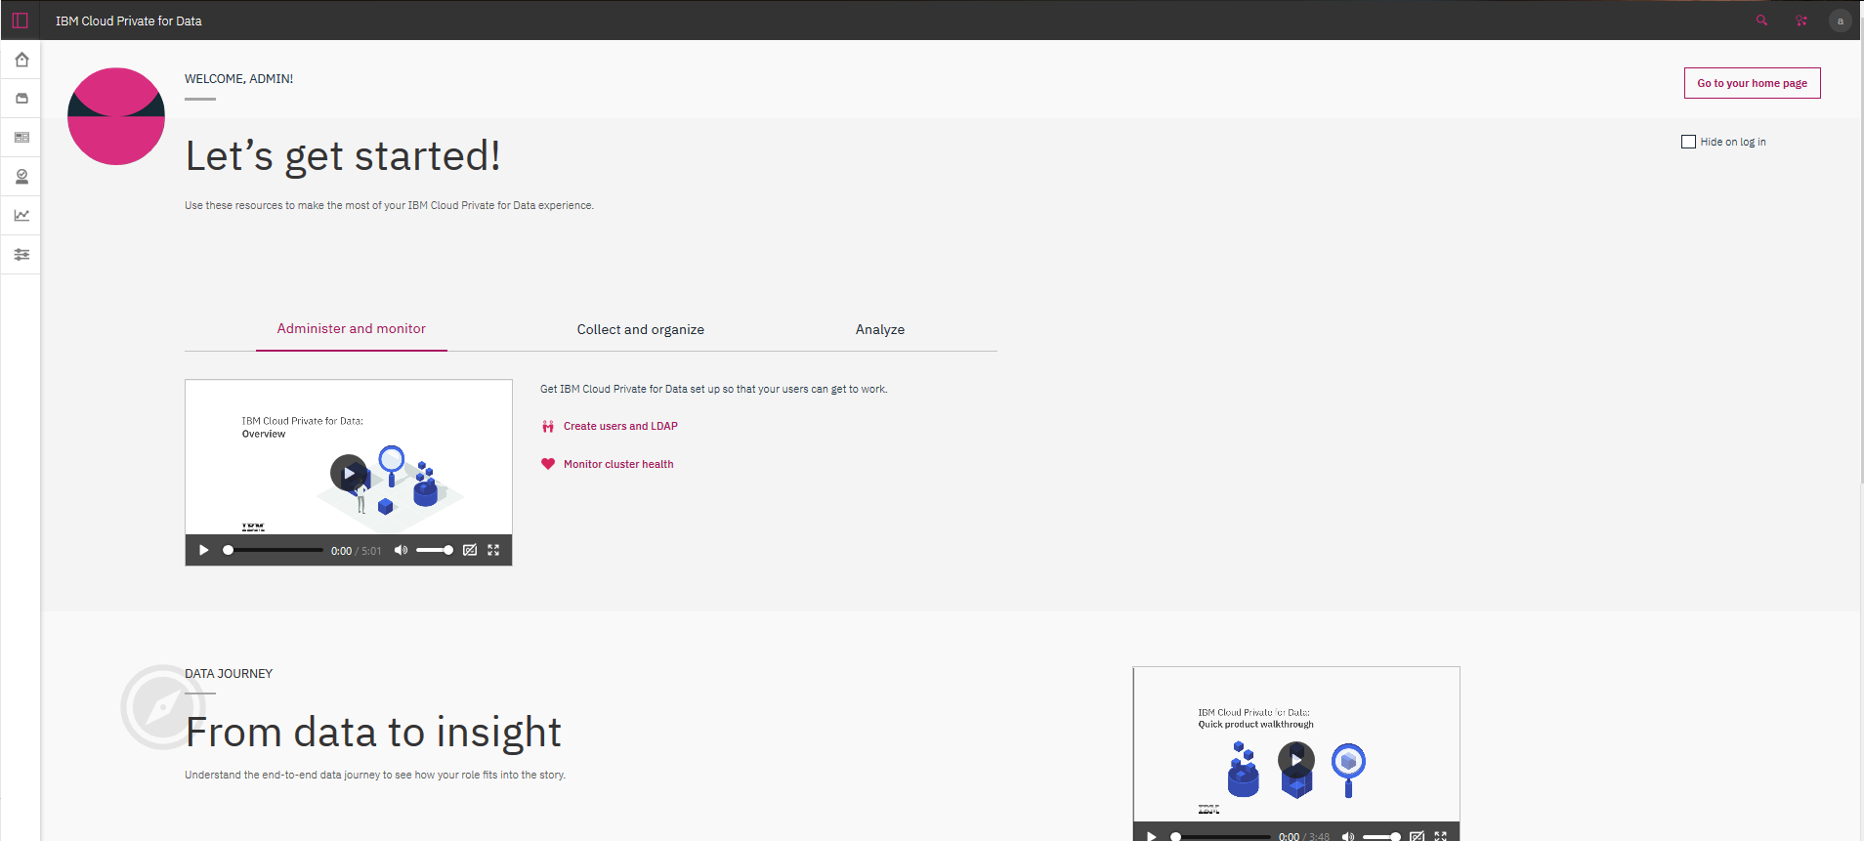
What to expect after install
Notes:
Success…and then use case with it …..

Slide 18
Instruction links
https://docs.openshift.com/container-platform/3.11/install/prerequisites.html#system-requirements
https://www.ibm.com/support/producthub/icpdata/docs/content/SSQNUZ_current/cpd/install/install.html
Notes:
Success…and then use case with it …..

